Slide 1
Welcome to GLPO!
Great Lakes Preservation Organization

Slide 2
Agenda/Topics To Be Covered
GLPO
History of company/company vision
Who’s who
Company policies
Benefits
Performance reviews
Other resources
Required paperwork
Summary

Slide 3
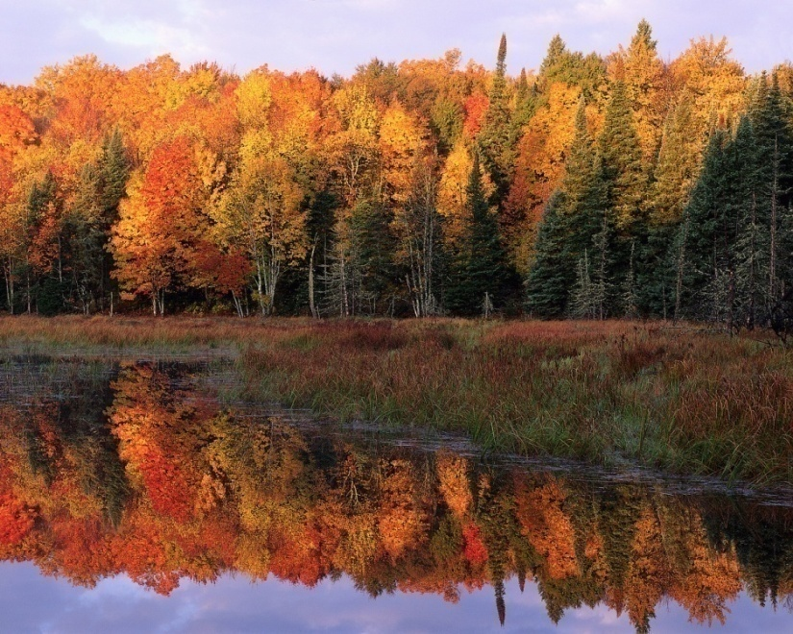
What We Do
GLPO
GLPO was founded by several environmentalists who were concerned about the Great Lakes.
GLPO has been an integral part of the preservation and protection of the Great Lakes and surrounding areas and continues to advocate its mission around the globe.

Slide 4
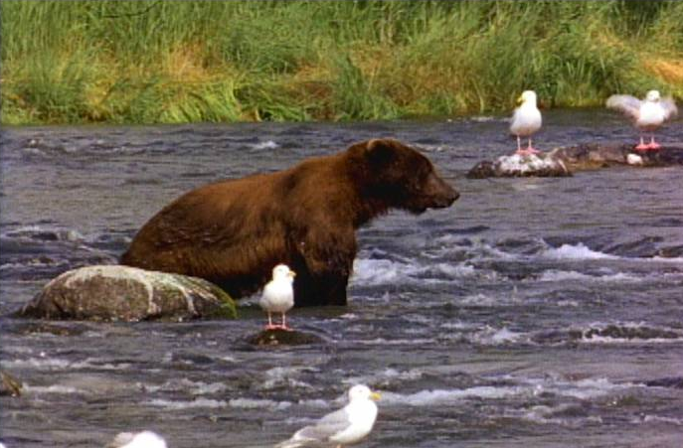
Important Facts
GLPO
GLPO
The Great Lakes and their connecting channels form the largest fresh water ecosystem in the world.
The Basin contains 20% of the world’s available surface water and is home to a variety of natural habitats.

Slide 5
GLPO
Jeanne Trudeau
Executive Director
Melissa Brown
Membership
Sali Roberts
Director
Chris Deane
Director
Alice Jansky
Director
Beth Dahl
Programs
Who’s Who

Slide 6
Company Policies
GLPO
Hours: 9 a.m. – 6 p.m. M-F
Some weekend hours, depending on projects
Distribute the company handbook and answer questions

Slide 7
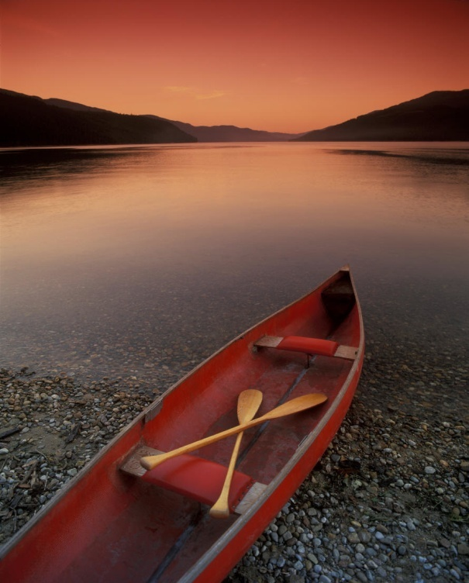
Other Resources
GLPO
Company handbook
Employee handbook
Contact/phone list

Slide 8
Summary
GLPO
GLPO is proud to have you here!

